Slide 1
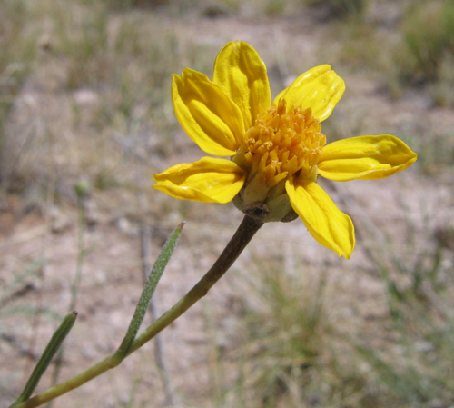
Red Rock Sunflower (Helianthus devernii) Status from BLM Perspective
Lillian Setters, Botanist
Bureau of Land Management, Southern Nevada District

Slide 2
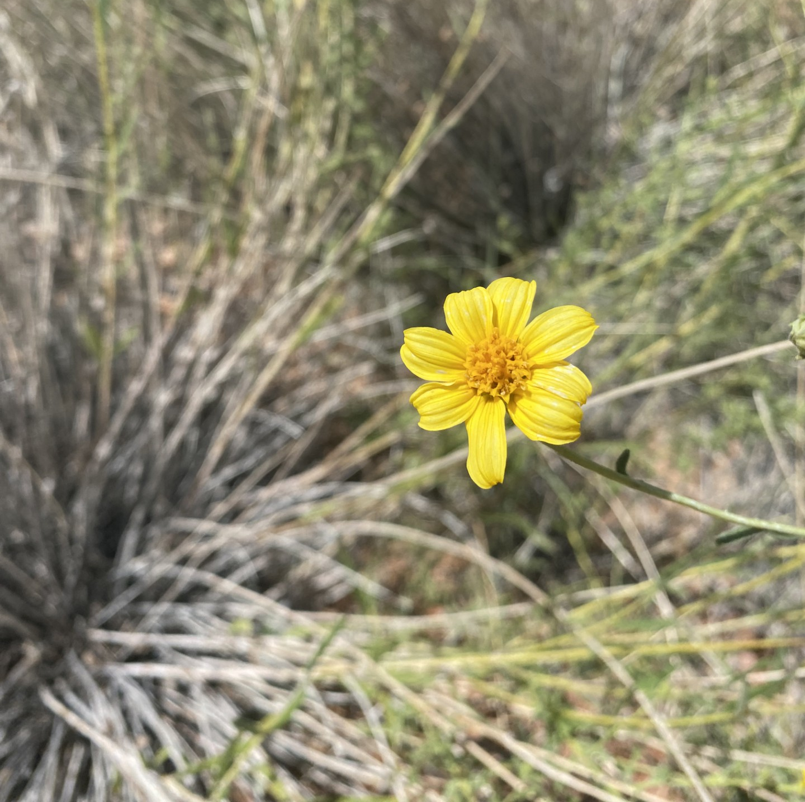
Threats
Small geographic range
Wildfire
Natural Disaster
Development
Visitation

Slide 3
Future Work
Seed Banking
Surveys
Research
Habitat Restoration
Monitoring

Slide 4
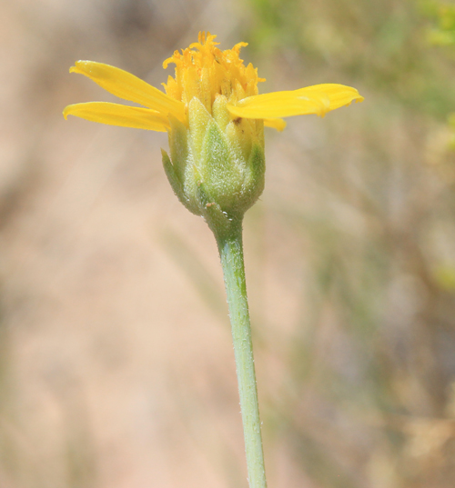
Questions? lsetters@blm.gov

