Slide 1
Proposed Permanent Regulation Workshop
Nevada Administrative Code
Chapter 527
June 13, 2022
______
Presented by
Kacey KC,
State Forester Firewarden
forestry.nv.gov l @NevDCNR

Slide 2
Title : Candara, bold, small caps
AGENDA ITEM III.
Overview and Discussion of Proposed Changes to NAC Chapter 527
The purpose of the workshop is to solicit comments from interested persons on proposed permanent changes to NAC 527:
Clarifying the process to petition and list native flora for full protection,
Clarifying the listing amendment process as authorized in Nevada Revised Statute (NRS), Chapter 527, and
Updating the Nevada Natural Heritage Program name and duties
2

Slide 3
Section 1.
NAC 527.010
- - - - - - - - - - - - - - - - - - - - - - - - - - - - - - - - - - - - - - - - - - - - -
3. The State Forester Firewarden will rely to the extent practicable upon the most recent edition of the International Code of [Botanical] Nomenclature for algae, fungi, and plants [(Saint Louis Code), 2000 edition,] as amended periodically by the International Botanical Congress, which is hereby adopted by reference, to [describe] determine the correct scientific name(s) and synonym(s) of the species and subspecies of native plants critically endangered and threatened with extinction. The International Code of Nomenclature for algae, fungi, and plants publication [may be purchased from Koeltz Scientific Books, P.O. Box 1360, D-61453 Königstein, Germany, for the price of $52. The publication] is [also] available, free of charge, from the International Association for Plant Taxonomy[.] [at the Internet address http://www.bgbm.fu-berlin.de/iapt/nomenclature/code/default.htm]

Slide 4
Section 2: nac 527.110
Section 3: nac 527.200
Section 5: nac 527.360
- - - - - - - - - - - - - - - - - - - - - - - - - - - - - - - - - - - - - - - - - - - -
Mission:
To maintain biodiversity data for Nevada’s at-risk plants and animals to support informed land use planning and conservation planning decisions.

Slide 5
Section 3.
NAC 527.200
- - - - - - - - - - - - - - - - - - - - - - - - - - - - - - - - - - - - - - - - - - - - -
1. The Nevada Division of Natural Heritage [Program] will:
(a) [Establish and maintain a committee of qualified professionals to conduct scientific research and analysis of native flora;
(b) Maintain data and records related thereto; and
(c) Subject to the approval of the Director, provide] Continually review all relevant research and data concerning native flora.
(b) Provide assistance to the State Forester in the development and administration of a program for the conservation, protection, restoration, and propagation of critically endangered species of native flora, by considering:
(1) Whether any species or subspecies of native flora should be added to or removed from the list of fully protected species of native flora.
(2) Whether, under all relevant circumstances, any component of the program administered by the State Forester for the conservation, protection, restoration, and propagation of a species or subspecies of native flora could be expanded, changed, or otherwise improved.
(3) Whether, under all relevant circumstances, a management area should be established, or the boundaries of an existing management area should be altered.
(4) Whether a permit should be issued, denied, amended, or revoked in order to carry out the provisions of NRS 527.260 to 527.300, inclusive.
(c) Provide any recommendations pursuant to this subsection in writing to the State Forester.
2. Pursuant to paragraph (b)(1) of subsection 1, [If] if the Nevada Division of Natural Heritage [Program] determines that the existence of a species or subspecies of native flora is endangered and the survival of that species or subspecies requires assistance because of overexploitation, disease or other factors, or because the habitat of the native flora is threatened with destruction, drastic modification or curtailment, the Nevada Division of Natural Heritage [Program] will notify the State Forester and recommend that the species or subspecies of native flora be placed on the list of fully protected species of native flora.

Slide 6
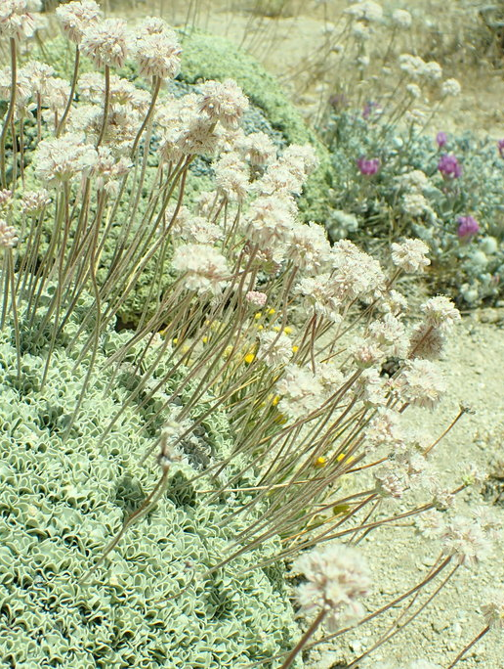
Section 4 NAC 527.250
- - - - - - - - - - - - - - - - - - - - - - - - - - - - - - - - - - - - - - - - - - - - -
Removes a State Parks exemption consistent with changes made to NRS 527 in the 80th Session of the Nevada Legislature.

Slide 7
Section 6.
NAC 527.550
- - - - - - - - - - - - - - - - - - - - - - - - - - - - - - - - - - - - - - - - - - - - -
NAC 527.550 Petition to [adopt,] amend [or repeal regulation] the list of fully protected species of native flora: Contents; notification of decision of State Forester. (NRS 233B.100)
1. Any interested person may request that the State Forester [adopt,] amend [or repeal a regulation] the list of fully protected species of native flora by submitting a written petition to the Division on a form provided by the Division [or in a format that is substantially similar to that form]. The petition must include:
(a) The name, organization or affiliation, and mailing address of the petitioner;
(b) The signature of the petitioner and the date the petition was signed;
(c) A statement of the reasons for the proposed [adoption]amendment [or repeal of the regulation], including but not limited to:
(1) Location of the proposed native flora species and its habitat;
(2) Current status of native flora species and its habitat;
(3) Current status and changes in threats, extinction potential, protections, and conservation of the native flora species, including associated timeframes;
(4) Current status and changes regarding overexploitation, disease, or other factors threatening the survival of the species;
(5) Current status and changes regarding threatened destruction, drastic modification, or severe curtailment of habitat; and
(6) Any other known scientific information and/or data on the species.
(d) An estimate by the petitioner of all known direct adverse and/or beneficial economic effects of the amended regulation [to be adopted, amended or repealed] on the general public and the business that it regulates or will [regulate] otherwise impact [, including, without limitation, the adverse and beneficial effects, and the immediate and long-term effects];
(e) An estimate by the petitioner of the cost to the Division for enforcement or implementation of the amended regulation [to be adopted, amended or repealed];
(f) A statement concerning the regulations or jurisdiction of other federal, state and local governmental agencies that overlap or duplicate the amended regulation [to be adopted, amended or repealed], including, without limitation, a specific reference to any such regulation or jurisdiction;
[(g) A statement indicating whether the regulation to be adopted, amended or repealed establishes a new fee or increases, reduces or eliminates an existing fee; and]
[(h)] (g) Any other related data or relevant information [relevant data, views and arguments] in support of the petition[.] ; and
(h) All information required in the petition under subsections (c) through (g) shall include applicable reference and/or citation.
2. Within [30] 90 days after a petition is submitted, the State Forester will:
(a) Notify the petitioner in writing of his or her decision to deny the petition and the reasons for the denial; or
(b) Initiate the [adoption, amendment [or repeal of the] amended regulation in accordance with the procedures set forth in chapter 233B of NRS.

Slide 8
Section 7.
NAC 527.560
- - - - - - - - - - - - - - - - - - - - - - - - - - - - - - - - - - - - - - - - - - - - -
1. Any interested person who alleges that a statute, regulation or decision of the Division interferes with or impairs, or threatens to interfere with or impair, his or her legal rights or privileges, may submit a written petition to the State Forester for a declaratory order or an advisory opinion regarding the applicability of the particular statute, regulation or decision.
2. Within [30] 90 days after a petition for a declaratory order or an advisory opinion is submitted, the State Forester will:
(a) Notify the petitioner in writing of his or her decision to deny the petition, including the reasons for the denial; or
(b) Initiate the preparation of a declaratory order or an advisory opinion concerning the validity of the statute, regulation or decision to be mailed to the petitioner within 30 days after the decision is reached.

Slide 9
Contact
Discussion
Kacey KC, State Forester Firewarden
Nevada Division of Forestry
Phone: 775-684-2500
Email: kaceykc@forestry.nv.gov
website.nv.gov l @NevDCNR
forestry.nv.gov l @NevDCNR

