Slide 1
Nevada Division of Forestry FY21 Grants Guidance
Landscape Scale Restoration (LSR)
Western State Fire Managers (WSFM)
&
Hazardous Fuels - Community Protection (HF-CP)
Nate -State and Volunteer Fire Assistance
Michael Vollmer – Urban and Community Forestry Coordinator
January 13th, 2020
Notes:
This presentation will cover elements of developing successful project pre-proposals that could potentially qualify for either the Landscape Scale Restoration, Western State Fire Managers, or Hazardous Fuels-Community Protection grants.
It includes an overview of process, timeline, types of projects that qualify for each grant program along with general guidelines and criteria.
It up to your organization to decide what grant program would best serve your needs.

Slide 2
Overview
Fund source – USDA Forest Service
17 western states compete for the grant funds
NDF solicits proposals from partners
NDF is the final applicant
Notes:
Overview
Regional funds for these grants comes to NDF from the USFS State and Private Forestry. Nevada will compete with 17 western states and the Pacific Island.

Slide 3
Process
Pre-Proposal
Submission (Project Proponent)
Pre-Proposal Review and Selection
(NDF Advisory Committee)
Full Proposal
Development
(NDF & Project Proponent)
Submit Application to Western Competitions
(NDF)
Notes:
Stages:
Pre-proposal: NDF and the Nevada Lands Resource Coordinating Council will review and select projects to move forward into full proposals and final competition.
Questions listed on the pre-proposal applications are similar to the final proposal. When answering the questions, it is important to keep the western criteria, found on NDF’s Grants webpage, close by. It will tell you how to gain the most points for each question on the application.

Slide 4
Pre-Proposal Application
Applicants can request up to $300,000 per project proposal.
Eligible applicants include other state and local governmental agencies, tribes, non-profit organizations, homeowners associations, owners of large private land tracts and educational institutions.
Applicant provides 1:1 match (LSR) or ≥10% match (HF-CP & WSFM).
Funds cannot be spent on federal lands.
Financial or in-kind partner leverage is important.
Notes:
Over view
$300,000 is available for each grant, however, NDF limits our partner request to $205,000 if NDF will be implementing the project with conservation crews or $292,000 if the partner will receive a subgrant to implement the project themselves or by using contractors.
When LSR projects are submitted to the west, they require a 1:1 match. HF-CP and WSFM grants require at least 10% match.
Leverage is above and beyond match. This can come from federal sources or items outside our grant authorities. i.e.. we can’t pay for a certain portion of the project, but if you plan to install one, this cost can be used as leverage to increase the value and contributions to the project.

Slide 5
Timeline
2020
1/8/20 | Announcement of request for LSR, WSFM & HF-CP Pre-proposals.
2/15/20 | HF-CP Pre-proposals due to NDF; Advisory Committee Reviews/Ranks; Selected proposals revised for final submission.
3/1/20 | LSR & 1st Round of WSFM Pre-proposals due to NDF; Final HF-CP Proposals due.
3/20/20 | Advisory Committee Reviews/Ranks LSR & WSFM Pre-proposals. Selected proposals developed for final submission.
5/30/20 | 2nd Round of WSFM Pre-proposals due to NDF.
July 2020 | HF-CP funds available for project implementation (if awarded).
7/19/20 | LSR & WSFM developed proposals due to NDF for internal review and final edits.
8/16/20 | Final LSR & WSFM Proposals due to NDF program coordinator(s).
Late August – Early September 2020 | NDF submits LSR & WSFM Proposals to the Western States Competitive Granting Process.
October-November 2020 | Review Teams score and rank proposals, and make funding recommendations to the Washington Office of US Forest Service.
December 2020 | Anticipated funding lists announced for LSR & WSFM (funding not guaranteed).
2021
7/1/2021 | Dependent on congressional appropriations, states receive LSR & WSFM funding.
7/15/2021 | NDF develops partner agreements to begin LSR & WSFM project work.

Slide 6
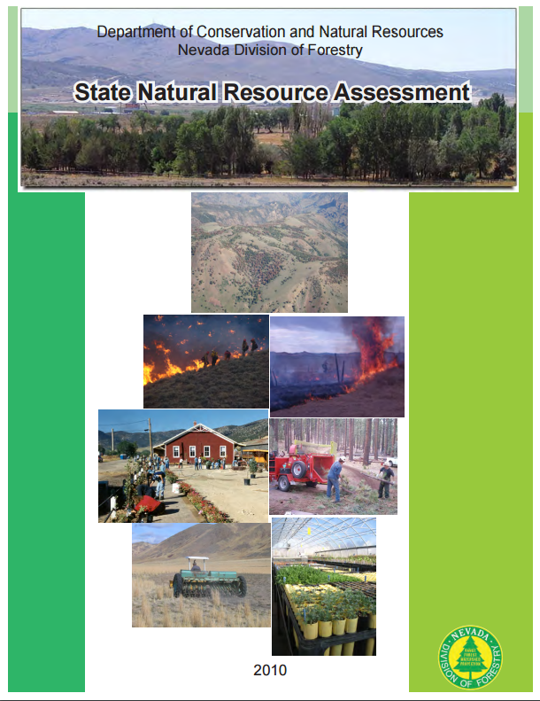
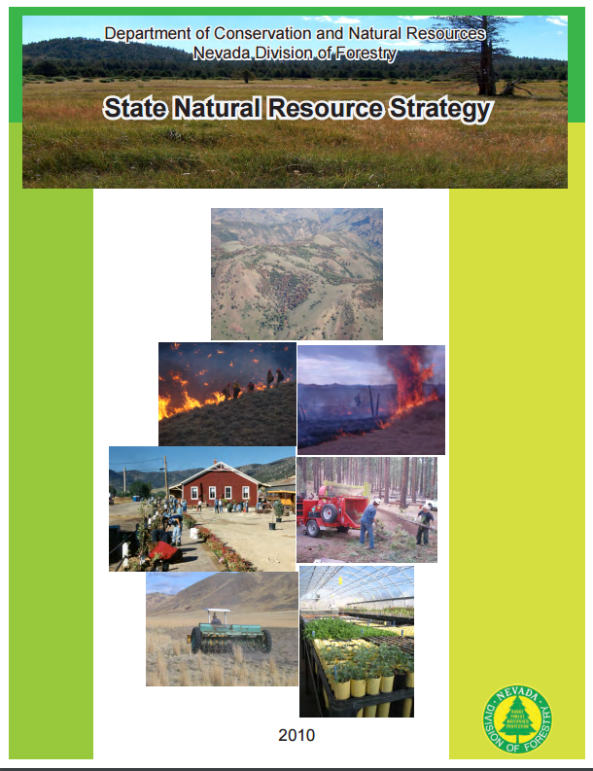
Projects Must Address:
Nevada Forest Action Plan
State Wide Forest Resource Assessment and Strategy
http://forestry.nv.gov/forestry-resources/state-resource-assessments/
Notes:
All projects must address issues identified in Nevada’s Forest Action Plan. The Plan is found on NDF’s website.
The Forest Action Plan was developed by a cross section of stakeholders throughout the state.

Slide 7
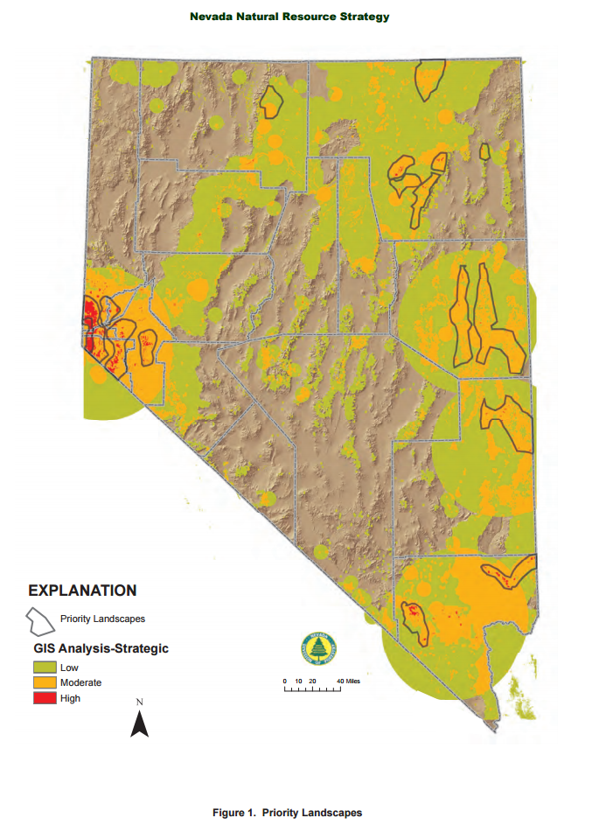
Nevada’s Priority Landscapes
Notes:
Nevada Division of Forestry has delineated 17 priority landscapes through out the state. These landscapes are derived from a subset of the GIS layers used in the state assessment and only relate to private lands. These landscape areas all have issues that area addressed in the state wide threats, but NDF wanted to address more specific strategies and resources in these areas. It should be noted that most of these areas also fall into Nevada’s Forest Legacy areas. Several of these area have the potential to tie into multi-state projects with neighboring states. The statewide CWPP data for risk was extracted for the priority landscapes. Only those that ranked from moderate to extreme are mentioned. The more specific issues have been derived from the 11 different layers that were used on this analysis. When five or more layers were identified, it created the priority landscape areas. A GIS function combined all the layers, which helped determine what layers contributed to the high value. The layers used in this analysis were made up of land attributes like ownership status and planning activities, as well as actual issues or threats such as wildfire hazards, and impaired watersheds or annual grass presence. All communities in the state have been designated as priority landscapes. The important role urban and community forests play in resident’s and visitor’s quality of life, as well as their ecological benefits in otherwise impaired environments leads to this designation.

Slide 8
Landscape Scale Restoration (LSR) Grant
NDF
Can submit 3 LSR applications for competition with western states, including one multi-state proposal.
Projects are selected and developed from successful pre-proposals.
Projects
Address national/state themes to protect, enhance and conserve forests.
Funding Authorities:
Forest Stewardship
Forest Health
Fire

Slide 9
LSR Projects
Innovative projects that focus on collaborative efforts among multiple stakeholders.
Project work crosses ownership, management and/or jurisdictional boundaries. (Note: while grant dollars cannot be spent on federal lands. Adjacent federal projects may be used as a source of funding leverage.)
Address local or statewide forest resource issues in Nevada’s Forest Action Plan.
http://forestry.nv.gov/forestry-resources/state-resource-assessments/
Notes:
Innovative projects are sought that integrate various programs (e.g., Forest Health, Stewardship, Fire Assistance, etc.) and partners and cross any combination of ownership, management or jurisdictional boundaries. Cross-boundary projects are encouraged as they expand project outcomes at watershed, regional and state levels. For example, within a watershed or Priority Landscape Area, multiple landowners and organizations might work together

Slide 10
Types of LSR Projects
Assess needs, develop plans (e.g., watershed action plans and Forest Stewardship Plans)
Project activities should maintain and increase vegetation diversity and resiliency. Desirable project outcomes include:
Improved/restored forest health, air and water resources, riparian areas, wildlife habitat, recreation opportunities and strengthen rural economies.
Improved management of hazardous fuels, noxious weeds, development pressures and impacts from undesignated recreation.

Slide 11
Types of LSR Projects
Address community issues such as stormwater, air quality, energy use, or invasive species.
Work with local and state governments to affect policy changes, develop plans, or conduct statewide training.
All projects should include outreach and education to relevant audiences:
Landowners
Local organizations
Proposal examples can be viewed on the Western LSR site:
https://www.forestrygrants.org/westernLSR/

Slide 12
LSR Grant Dollar Restrictions
Grant dollars cannot be used for:
Project work on federal land.
Land purchases.
Research-related activities. Research institutions may serve as project partners by providing technical assistance, education and outreach, however.
Construction activities - new or improved structures, roads, bridges and culverts. If these activities are part of the overall project, use them as project leverage.
Equipment purchases >$5,000, unless prior approval has been granted.

Slide 13
Developing LSR Projects
What’s worked well:
Start Early! Good project proposals take 6-12 months to fully mature.
Hold planning meetings with potential partners.
Identify and discuss potential issues.
Find out who is doing what, where. Identify gaps.
Support project with data, assessments and maps.
Identify specific and measurable project deliverables & outcomes.

Slide 14
Leverage & Partnerships
Partnerships are key!
Sizeable match and leverage contributions demonstrate collaboration and widespread support.
Leverage is defined as funding available/committed to project activities that is not allowable as match.
Additional federal funds/resources are often used as leverage. Cannot be used as match/in-kind.
Partnering organizations can provide leverage through project development, implementation and complementary work on federal lands.

Slide 15
LSR Pre-Proposal Application
Project Overview – 500 Character Limit
Provide succinct overview of the proposed project; overview easily communicates the main elements and value of the project.
Context, Goals and Objectives – 2,000 Character Limit
Clearly identify priority landscapes and issues/opportunities to be addressed.
Address issues, opportunities and national themes.
Proposed Activities – 3,000 Character Limit
List and explain project activities that will be used to achieve goals and objectives.
Notes:
Overview: Provide succinct overview of the proposed project. Include who is doing what, where and why. Provide the “big picture”.
Context, Goals and Objectives:What resource issue(s), threats and/or opportunities does the project address? What are the project goals and objectives? What impacts do you hope to achieve?
Activities: List and explain project activities (work that will be done to achieve goals and objectives). Indicate what activities will be done with grant funds, what is to be completed with leveraged funds, and who will do the work.
What are the project deliverables, outputs, and outcomes? (Outcomes and outputs should relate directly to proposed activities, goals and objectives.
Describe collaborative efforts in developing and implementing the project. List partners and their type of contribution (planning, treatments, etc) and the dollar value (in-kind or cash). The dollar value will be used as leverage in support of the project, more is better.
a) How does the project align with stated priority issues, areas, and activities in the State Forest Action Plan? b) What scale is the project and how will it facilitate achievement of the stated goals, objectives and outcomes? Sustainability c) What skills and capabilities will result from and extend beyond the life of the projects?
Project implementation readiness—if not currently ready, estimate time needed to prepare; b) if the project is new or a continuation/expansion of a current project
Basic budget, list the activity, such as assessment, plans, treatment, the grant dollars and leverage (at the full proposal stage we will need 10% match.)

Slide 16
LSR Pre-Proposal Application
Deliverables and Outcomes – 2,000 Character Limit
What are the project deliverables and outcomes? Outcomes should relate directly to project goals and objectives, and proposed activities. Provide clear, quantitative measures of success.
Collaboration/Cross-Boundary – 2,000 Character Limit
Describe collaborative efforts in developing and implementing the project. List partners, their contribution and the value (in-kind or cash). Dollar values should match budget worksheet.
Forest Action Plan Integration – 1,250 Character Limit
Address how project relates to one or more priority landscapes, issues, areas, or strategies identified in the Forest Action Plan.
Notes:
Deliverable, Outputs and Outcomes: What are the project deliverables, outputs, and outcomes? Outcomes and outputs should relate directly to proposed activities, goals and objectives. Provide quantitative measures of success.
Collaboration: Describe collaborative efforts in developing and implementing the project. List partners and their type of contribution (planning, treatments, etc.) and the dollar value (in-kind or cash). The dollar value will be used as leverage in support of the project, more is better. Describe how partners are committed and will add value during project development and implementation.
Forest Action Plan: Clearly describes the need for the proposed project and relates it to one or more priority landscapes, issues, areas, or strategies identified in the Forest Action Plan.

Slide 17
LSR Pre-Proposal Application
Meaningful Scale/Cross Boundary – 1,250 Character Limit
Scale of the project is appropriate for the stated goals, objectives and outcomes, including cross boundary goals. Scale is sufficient to address identified themes and issues.
Sustainability of Outcomes – 1,250 Character Limit
Indicate how project will lead to specific, quantifiable, cost-effective and replicable benefits that address national themes.
Project Budget
Budget worksheet includes funds requested by applicant, match and leverage amounts.
Contact NDF Stewardship/Legacy Coordinator for assistance.
Notes:
Scale: Scale of the project is clearly based on and is appropriate for the stated goals, objectives, and outcomes including cross boundary goals. The scale is sufficient to address the national theme and priority landscape and issues.
Sustainability: What skills and capabilities will result from and extend beyond the life of the projects? Project shows how investments will lead to specific, quantifiable, cost-effective, and replicable benefits.
Implementation.
Indicate:
project implementation readiness—if not currently ready, estimate time needed to prepare;
if the project is new or a continuation/expansion of a current project
Budget: estimate project costs for activities. Include grant funds requested, match and leverage amounts and sources.

Slide 18
Additional LSR Information
Go to NDF’s Grants webpage – http://forestry.nv.gov/grants/
Review CRITERIA. Projects are scored and ranked based on grant criteria.
Review past project proposals and reviewer comments.
Questions: Contact Mike Vollmer, mvollmer@forestry.nv.gov or 775-684-2530.

Slide 19
Western State Fire Managers (WSFM) & Hazardous Fuels-Community Protection (HF-CP) Grants
WSFM and HF-CP Program grants-modify fire behavior, protect life and property
NDF can submit 10 WSFM Grants
NDF can submit 3 HF-CP Grants
Notes:
All funding for the fire grants comes from USFS as pass through by NDF to sub-recipients.
In the next slide we will look at the specific criteria between these two funding sources.

Slide 20
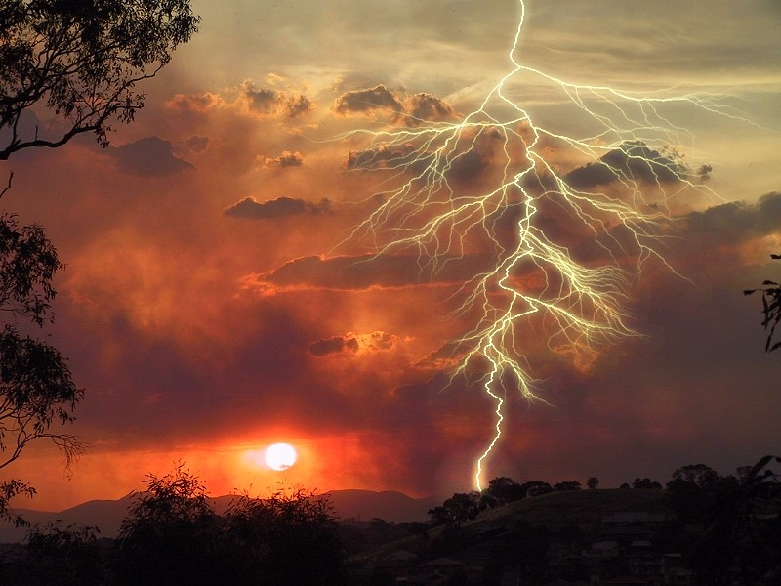
Fire Grant Criteria
Criteria
Hazardous Fuels -Community Protection (HF-CP)* | Western States Fire Managers (WSFM)*
Project MUST be in CWPP as a priority project | Project MUST be in CWPP or Propose to Complete a CWPP as part of the project
Project MUST be adjacent to recent, current or planned USFS project on USFS lands | Project NOT ownership adjacent specific
Project match of 10% or greater MUST be provided by the applicant or collaborator. Greater match and leverage will favor the grant. Cash or In-kind is acceptable. | Project match of 10% or greater MUST be provided by the applicant or collaborator. Greater match and leverage will favor the grant. Cash or In-kind is acceptable.
* All grant money is courtesy of the USFS
Notes:
Note: each grant type requires the project be listed in a County Wildfire Protection Plan. (CWPP)
Hazardous Fuels-Community Protection (HF-CP)– Projects must be directly adjacent to a USFS project area, not necessarily the treatment areas. The HF-CP grant requires 10% or greater match as part of the selection and prioritization process.
Western States Fire Manager Grant (WSFM) – Projects do not need to be adjacent to USFS projects. Requires 10% or greater match.
Grant dollars cannot be spent on federal lands, nor on database development, maintenance of previously federally funded projects and anything to do with suppression response (i.e. equipment purchases, FD training, road improvements, etc..)

Slide 21
WHAT IS A WSFM or HF-CP PROJECT?
Is pre-determined and pre-defined in a CWPP
EXAMPLES
Fuel Breaks
Shaded
Green Strip
Forest Thinning
Defensible Space
Watershed Protection
Etc.
Notes:
Projects that one would find in a CWPP include the following, fuel breaks (true, shaded or green strip), thinning, defensible space, watershed protection, etc….

Slide 22
Who Can Apply?
Any County with proof the project is identified in a CWPP
Local or state governments with proof the project is in a CWPP and they have capacity to manage project
Any accredited non-profit or company with proof the project is in a CWPP and they have capacity to manage project
Landowners that have private lands where community protection projects specified in CWPP are going to be implemented
Notes:
Applications can be received from any local, county or state government agency and also includes non-profits whom have the capacity to manage a project on the ground.

Slide 23
Grant Dollar Restrictions
WSFM and HF-CP Grants exclude:
Individual homeowner defensible space
Maintenance on previous federally funded fuels projects
Preparedness and suppression capacity building (e.g. purchase of fire department equipment)
Small business start-up funding
GIS/database development.
Notes:
A re-iteration of the cannot list.

Slide 24
Application Comparison
HF-CP
WSFM
Notes:
For the rest of the presentation we will look at the differences of the two applications. Some of the differences are slight but make a big difference in the required information in the application. Please remember the WSFM can be spent on any state or private lands while HF-CP has to be expended on state and private lands that are adjacent to USFS project areas. If you don’t know which of the two grants to chose or if you should apply using both please contact Mike Vollmer (mvollmer@forestry.nv.gov or 775-684-2511) and guidance will be provided.
Again information required in the HF-CP and WSFM applications is slightly different. Carefully read each line and fill in the field with the requested information. Please make sure each and every line is complete. The applications are accompanied with instructions and each box also has a set of instructions that if you hover in the box will show to quick reference.

Slide 25
HF-CP
WSFM
Notes:
Budget Differences:
HF-CP
Match required is 10% or greater, and it is a good idea to show partner leverage. These are contributions from the partners or public that add value to the overall project.
WSFM
10% or greater match is required. Distinguish between Applicant Match and other Non-Federal Contributors.

Slide 26
HF-CP
WSFM
Notes:
Only the HF-CP – requires a project summary section be completed.
The WSFM application will ask for a budget and project planning explanations.

Slide 27
HF-CP
WSFM
Notes:
The WSFM application includes a section to describe the project’s relevance and impact on the overall landscape.

Slide 28
HF-CP
WSFM
Notes:
When completing the last page of the applications, read the directions found in the pop-up boxes. Specifically, answer who, what, when and how the project will be maintained over time.

Slide 29
NDF Grants Website: http://forestry.nv.gov/grants/
Grant Contacts:
Landscape Scale Restoration
Mike Vollmer mvollmer@forestry.nv.gov
Phone: 775-684-2530
HF-CP and WSFM
Mike Vollmer mvollmer@forestry.nv.gov
Phone: 775-684-2530

